Slide 1
Cumene Plant
Start-up year : 1968
Nominal Capacity: 396 kt/a,
possibility of getting 420 kt/a
Raw materials: Benzene and Propylene
Tecnology: owner

Slide 2
Cumene Plant
Products specifications: 99,75 % wt
Raw Materials Consumption :
Propylene 0,367 kg/kg, benzene 0,622 kg/kg
Revamping: several, last one in 2000 allowed to apply the new owner technology and increased the nominal capacity to the present 396 kt/a

Slide 3
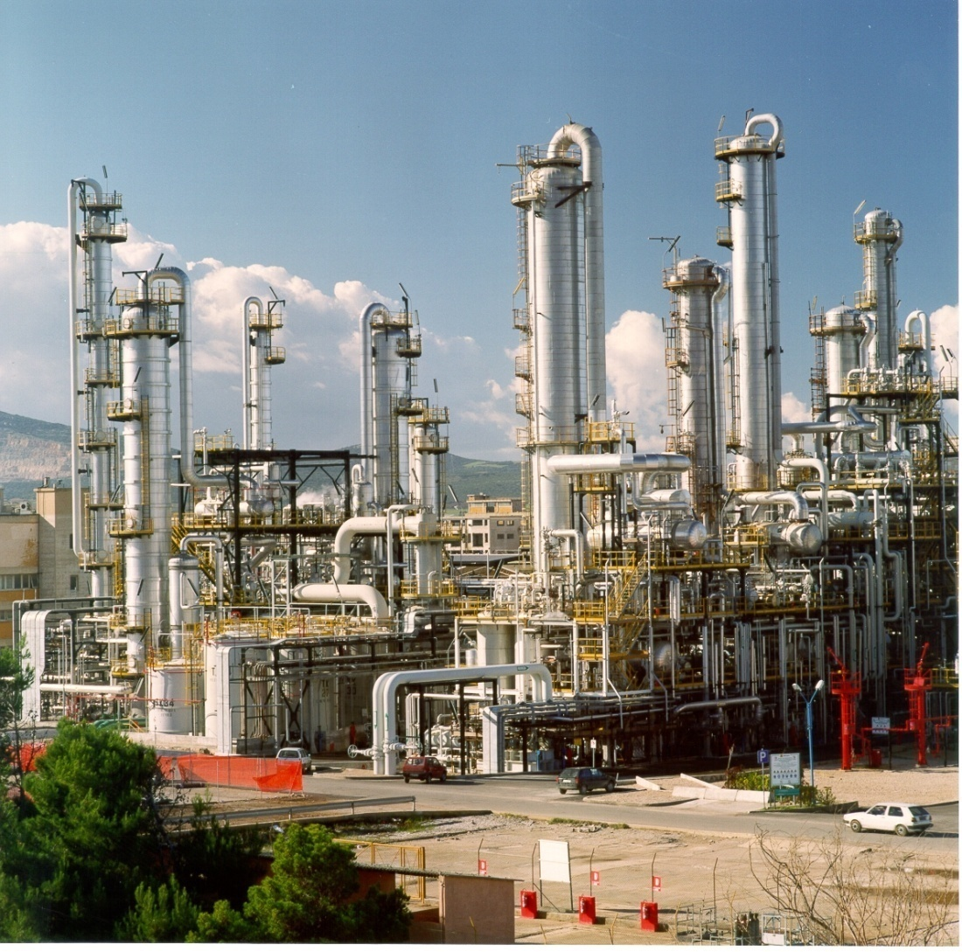
Phenol Plant

Slide 4
Phenol Plant
Start-up year: 1962
Nominal Capacity: 180 kt/a Phenol + di 112 kt/a Acetone;
maximum production up to 200 kt/a Phenol/ 125 kt/a Acetone
Raw material: Cumene
Tecnology: owner
Present situation: shut down since 2009

Slide 5
Phenol Plant
Products specifications:
Phenol 99,99 wt%, Acetone 99,9 wt%
Raw Materials Consumption: 1,352 t Cumene / 1 t Phenol + 1 t Acetone
Rewamping: several, last one in 2000 increased the nominal capacity from 110 kt/a to the present 180 kt/a

